Slide 1
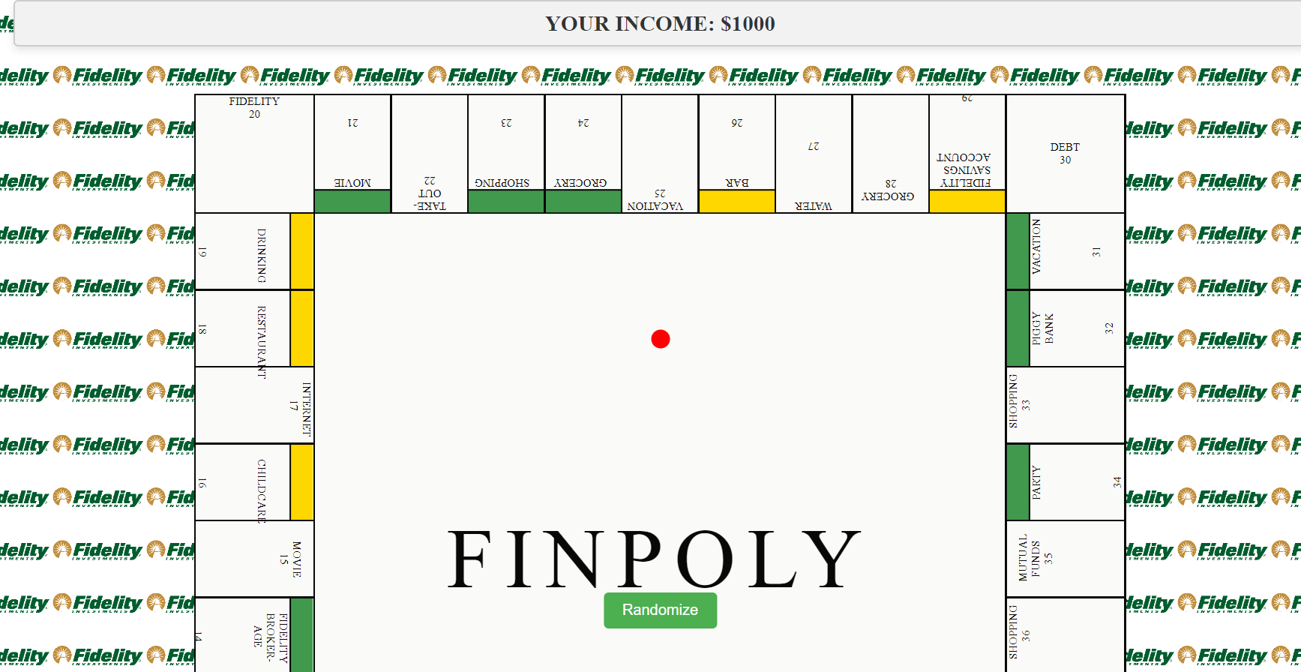
A fun way to learn about your spending habit playing a game

Slide 2
How do you play this game?
Users are prompted to input their monthly income.
Like in Monopoly, you have a pawn.
And you are going to randomize some numbers by which the pawn moves
The pawn moves to the various stages of the game, which represent real-life spendings
Spend your money as you like.

Slide 3
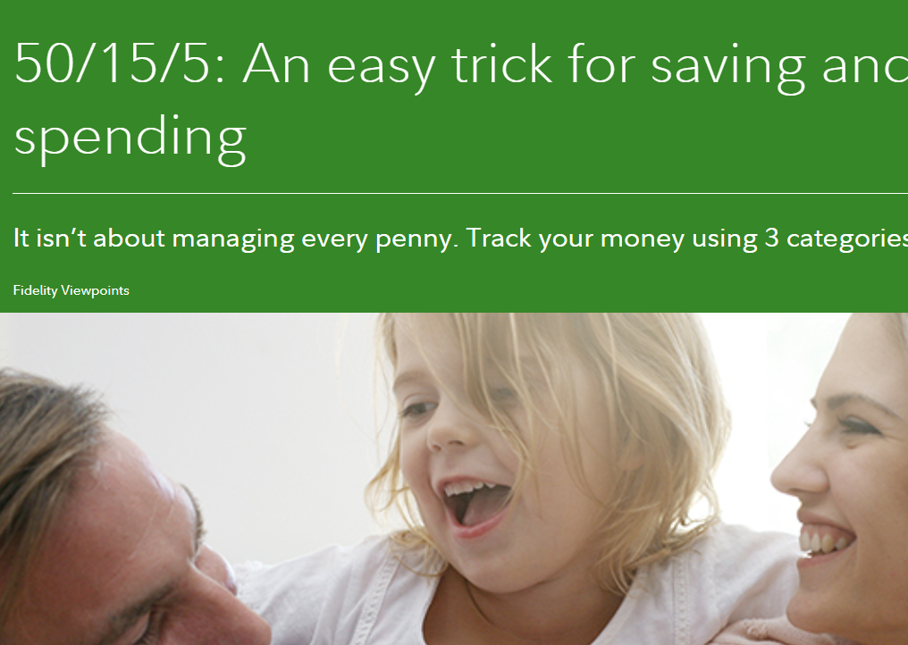
Easy Trick for Saving and Spending
50% of your paycheck for Essential Expense
15 % of your paycheck for Retirement Saving
5% for Short Term Savings

Slide 4
Slightly modified to 50/20/15/10/5 rule(The FINPOLY rule)
50% for Essential Expense
20% for your Wants
15% for your Retirement Savings
10% for Investment
5% for Short Term Savings

Slide 5
Thank You!

